Slide 1
Welcome Back
AP World History
Orientation

Slide 2
Orientation
Day 1: class foundation
Day 2: course foundation

Slide 3
Today day 1
Seats and names—Personal Introductions
REMIND
Website & Email
Textbook Orders
Expectations
  Behavior
  Mind-set
  Your academic structure
  Summer Assessments

Slide 4
Remind.com
Seats & Names
Name you want to be called
Hometown
Pets, Travel, Something few people know
Social Studies strength
APW1@93f8h2
APW2@akc44g7
APW4@chk7ag
APW5@337h4b
APW6@83f2a8

Slide 5
To enroll in this section online, sign into https://myap.collegeboard.org and enter the section join code
AP Classroom
APW1 VZVJ2Y
APW2 AAKJQV
APW4 3G2PGX
APW5 R96Y9A
APW6 GV2E6K

Slide 6

Website & E-Mail addresses
Textbooks order yours today
www.gcsnc.com/Grimsley_High
Staff directory
Joseph Hill
hillj2@gcsnc.com
https://www.perfectionlearning.com/social-studies/advanced-placement/world-history-ap-exam.html
in stock September 15

Slide 7
Expectations
1) Behavior→ class room rules & consequences
  * phones, charging, etc.→ this is your warning & SI Pass → Room 100
  * be on time, be present (the gift and power of this moment)
  2) Mind Set → mental toughness, perseverance
  * this will get you through the tough times ahead
  * dealing with stress → depressed and anxious: the Power of Right Now
  3) Academic Structure → What do you really mean when you say “I studied”?
  * Time management
  * Functional Workspace

Slide 8
Breakout
Reflect and write on your slip
Find 2 or 3 others, share & discuss

Slide 9
Define “Studying”
IDEAL Workplace

Slide 10
Typical nightly AMOUNT of time spent studying
Things that get in the way

Slide 11
Ideal Work Space
Time Management
* First step is to create a list of all the demands on your time
-- Then prioritize them
This will give you a much better feel for what needs to be done and the time it will take
* There is power in completing something and checking it off!
Check these out tonight:
https://www.youtube.com/watch?v=tZw8tnz-uv8
https://www.forbes.com/sites/hennainam/2013/12/20/time-management-101-stop-managing-time/#67c16dd324f9 (article)
* You need a place where you can do your best school work. It is not always quiet, but is always dependable.
* Eliminate distractions. Put away the phone for say, 30 minutes, then come back to it if needed.
* Have all necessary materials. Your workspace is organized will all the tools you need.
Check these out tonight:
https://www.thoughtco.com/create-a-study-space-1857109 (short & quick)
https://www.theinterngroup.com/our-blog/10-components-of-an-ideal-workspace/ (QUIET space preferences)
https://www.bing.com/videos/search?q=ideal+student+home+workspace&&view=detail&mid=DA3F9C704E5177088ED1DA3F9C704E5177088ED1&&FORM=VRDGAR

Slide 12
https://www.youtube.com/watch?v=9jjHKn4dyJs&feature=youtu.be (WHAP way)
https://www.youtube.com/watch?v=3XxbIVsCVmM (history of world in 2 minutes)
https://www.youtube.com/watch?v=fZfGodI5_Fc (history of world in 2:45—lighter)

Slide 13

Summer assessments

Slide 14
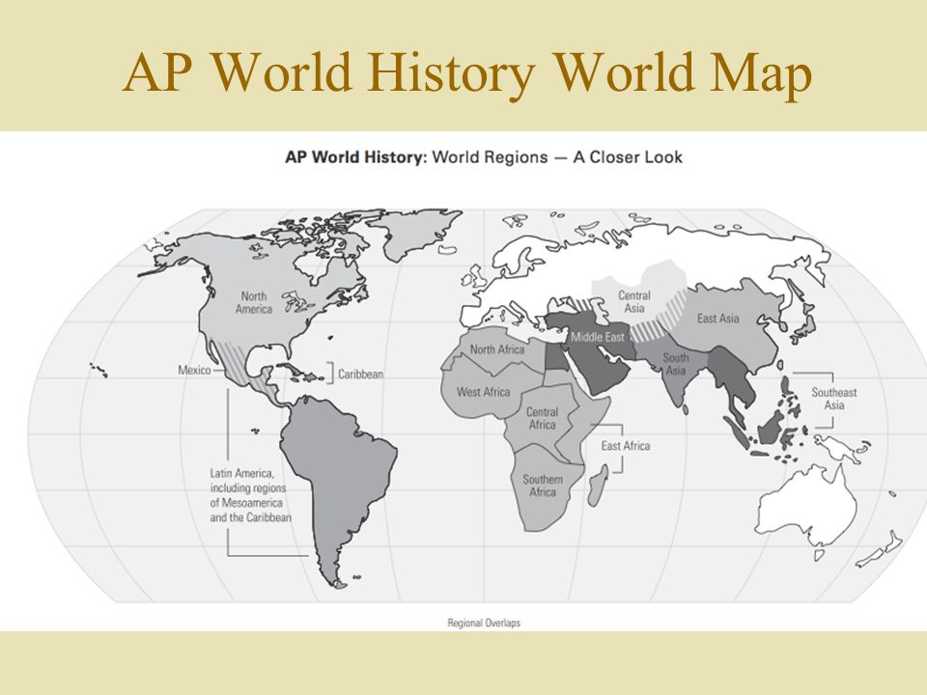
8 Geographical Regions
Where is Europe?
Page 1
Find someone who does not have a name for a region. Write their name down on that line.

Slide 15
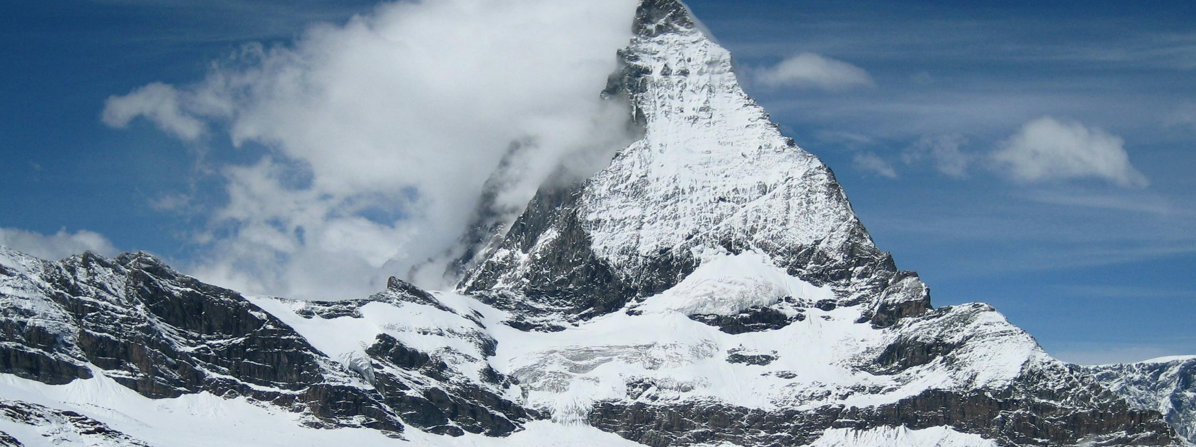
Orientation Day 2

Slide 16
Reflect
* REMIND.com
* Website
* TEXTBOOK orders—done yet?
* Expectations
-behavior/cell phones in class
-Mind set: Growth, Perseverance, Mindfulness & the Moment
-Your academic structure: got your Ideal Work space? Manage your time, reduce your stress
Summer assessments—lets finish up now

Slide 17
THEMES, PERIODS, AND SKILLS
six themes, Nine units, and Six historical skills needed to pass the AP Exam

Slide 18
Six HISTORICAL THEMES
Humans and the Environment (ENV)
Cultural Developments & Interactions (CDI)
Governance (GOV)
Economic Systems (ECON)
Social Interactions & Organizations (SOC)
Technology and Innovation (TEC)

Slide 19
HUMANS AND THE ENVIRONMENT (ENV)
Fundamental theme in World History
The environment not only shaped human societies, human societies also affected the environment
Before human migration led to the peopling of the earth, they interacted as hunters, foragers, fishermen, and later farmers or pastorals
Environmental factors such as rainfall patterns, climate, and available flora and fauna have also impacted life in different regions
Human impact only intensified as populations grew and people began migrating

Slide 20
CULTURAL DEVELOPMENTS AND INTERACTIONS (CDI)
Explore the origins, uses, dissemination, and adaptation of ideas, beliefs, and knowledge within societies.
Studying dominant belief system(s) or religions, philosophical interests and technical and artistic approaches to see how major groups view each other
Comparing social cultures to reveal what is both unique to a culture and what is shares with other cultures
Analyze and trace particular cultural trends or ideas across human societies

Slide 21
GOVERNANCE (GOV)
Understanding the processes by which hierarchical systems of rule have been constructed and maintained and the conflicts brought about by them
Organizational and cultural foundations of long-term stability and the internal and external causes of conflict
Discuss various forms of state development and expansion through various production strategies and cultural and ideological foundation.
Discuss different types of states, while also exploring interstate relations, warfare, diplomacy, and the formation of international organizations

Slide 22
ECONOMIC SYSTEMS (ECN)
Survey the divers patterns and systems that human societies have developed as they exploit their environments to produce, distribute, and consume desired goods and services across time and space.
Discuss patterns of trade and commerce between various societies
Influence of cultural and technological diffusion, migration, state formation, social classes, and human interaction with the environment
Discuss the development of various labor systems and economic systems

Slide 23
SOCIAL INTERACTIONS AND ORGANIZATION (SIO)
Focuses on relations among human beings.
Discuss how human societies develop ways of grouping members
Analyze the processes of how social categories, roles, and practices were created
Discuss connections between changes in social structures and other historical shifts

Slide 24
TECHNOLOGY AND INNOVATION (TEC)
Human adaptation of nature has provided tools giving us a huge advantage
Innovation of ideas continues to compound, from simple to complex, and increasing speed
TEC results in increased efficiency, comfort, and security
TEC advances have shaped human development & interactions with both intended and unintended consequences

Slide 25
Get to know the 6 Themes of WHAP
Group Assignment
1. I will assign each group one of the 6 themes.
  The person with the black marker will write the theme at the top of the paper.
  Other members choose different colored markers and write your name (small) at the bottom of the page.
  Introduce yourself to the group as you complete #1.
2. First, talk about the theme and what it means. Talk about examples of it in real life (now or in the past). Examples can be global or local (community, school, home).
NO USING ELECTRONIC DEVICES! Talk and help each other.

Slide 26
3. Once you have decided on examples (one for each member), have the member write it on the paper.
  Examples must be SPECIFIC! For example,
ENV=When the Cuyahoga River caught fire cuz of water pollution
GOV=GHS principal and asst. principals
Use bulleted phrases or words
4. Each group will show their examples to the class and explain why they fit the theme. Decide who will talk: everyone does their own? one person explains all? a few speak for the group?
copy them or take pics for your reference later.

Slide 27
NINE HISTORICAL UNITS; FOUR CHRONOLOGICAL ERAS
ERA 1
1200-1450
ERA 2
1450-1750
ERA 3
1750-1900
ERA 4
1900-present
The Global Tapestry: overview of the major cultural traditions
Networks of Exchange: trade over land and water, & the Mongol Empire, create large cultural connections
Land-Based Empires: dominant Asian, African, European, and American empires dominate world history
Transoceanic Connections: new technology leads to global exploration, establishing unprecedented trade and cultural connections
Revolutions: major political and industrial changes establish the basis for the modern world
Consequences of Industrialization: economic and political gaps begin and man’s impact on the environment accelerates
Global Conflict: World War and global depression lead to a shift in power
Cold War & Decolonization: Ideology defines a Superpower conflict, and scores of new nations are formed as Europe loses its colonies
Globalization: technology allows for a global diffusion of economics, culture, and disease

Slide 28
SIX HISTORICAL THINKING SKILLS (HTS)
Skill 1: Developments and Processes
Skill 2: Sourcing and Situation
Skill3: Claims and Evidence in Sources
Skill4: Contextualization
Skill 5: Making Connections – use historical reasoning processes, such as comparison, causation, continuity and change
Skill 6: Argumentation

Slide 29
Skills 2 & 3: ANALYZING EVIDENCE: CONTENT AND SOURCING
Explain the relevance of the author’s point of view, purpose, historical situation, and/or audience
Make and support a claim by showing understanding of a primary source
Compare the arguments or main ideas of two sources

Slide 30
Skill 6: ARGUMENTATION
Make a historically defensible claim in the form of a clear and compelling thesis
Support a historical argument using historical evidence within a specific reasoning process
Corroborate, qualify, or modify and argument using evidence to make a new argument

Slide 31
Reasoning Processes
Comparison
Causation
Continuity & Change
* Describe similarities and/or differences between different historical developments or processes
* EXPLAIN the sims/diffs and the significance of sims/diffs between historical developments or processes
Describe causes and/or effects of a specific historical development or process
EXPLAIN the relationship, or difference, between causes and effects of specific historical developments or processes
Describe patterns of continuity and/or change over time
EXPLAIN patterns, or significance, of specific historical developments in relation to a larger pattern of continuity and/or change

Slide 32
8 Geographical Regions
Get out this from yesterday.
Now do the same thing for Page 2

